Slide 1
DIVIDE AND CONQUER

Slide 2
WHAT IS DIVIDE AND CONQUER ALGORITHM?
In divide and conquer approach, the problem in hand, is divided into smaller sub-problems and then each problem is solved independently. When we keep on dividing the sub problems into even smaller sub-problems, we may eventually reach a stage where no more division is possible. Those "atomic" smallest possible sub-problem (fractions) are solved. The solution of all sub-problems is finally merged in order to obtain the solution of an original problem.
This technique can be divided into the following three parts:
Divide: This involves dividing the problem into some sub problem.
Conquer: Sub problem by calling recursively until sub problem solved.
Combine: The Sub problem Solved so that we will get find problem solution.

Slide 3
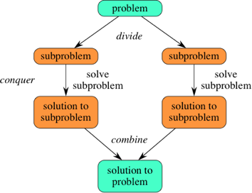

Slide 4
Advantages of Divide and Conquer.
The most recognizable benefit of the divide and conquer paradigm is that it allows us to solve difficult problem, such as the Tower of Hanoi, which is a mathematical game or puzzle. Being given a difficult problem can often be discouraging if there is no idea how to go about solving it. However, with the divide and conquer method, it reduces the degree of difficulty since it divides the problem into sub problems that are easily solvable, and usually runs faster than other algorithms would.
It also uses memory caches effectively. When the sub problems become simple enough, they can be solved within a cache, without having to access the slower main memory.

Slide 5
Disadvantages of Divide and Conquer
One of the most common issues with this sort of algorithm is the fact that the recursion is slow, which in some cases outweighs any advantages of this divide and conquer process.
Sometimes it can become more complicated than a basic iterative approach, especially in cases with a large n. In other words, if someone wanted to add a large amount of numbers together, if they just create a simple loop to add them together, it would turn out to be a much simpler approach than it would be to divide the numbers up into two groups, add these groups recursively, and then add the sums of the two groups together.

Slide 6
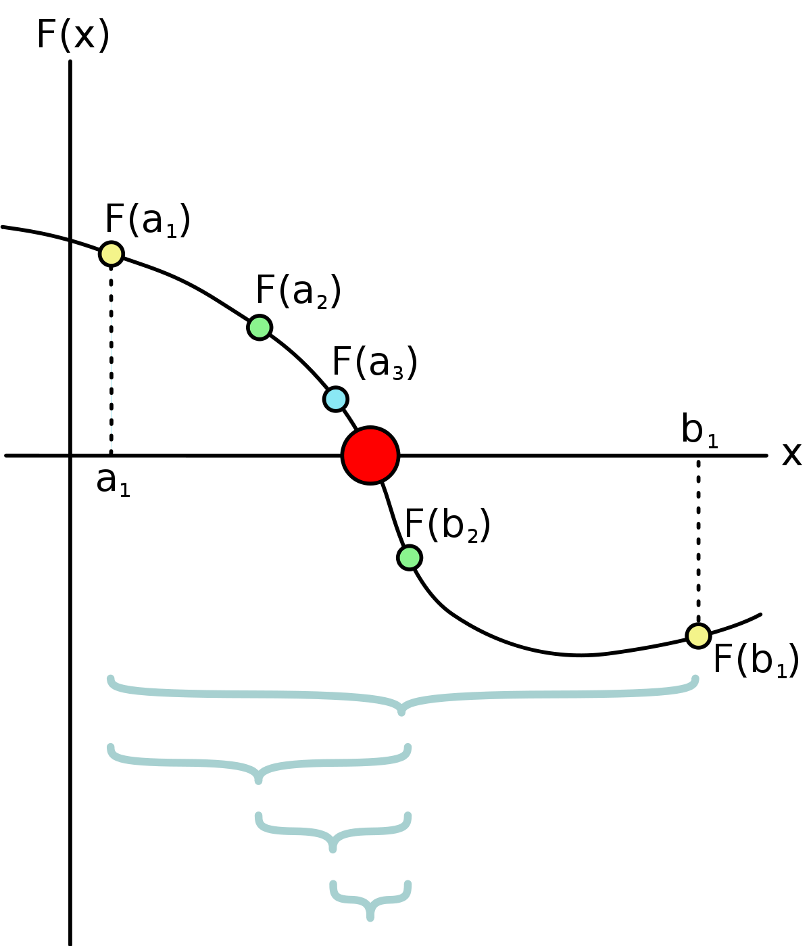
Finding the root of an equation using bisection method.
The method is also called the interval halving method, the binary search method or the dichotomy method. This method is used to find root of an equation in a given interval that is value of ‘x’ for which f(x) = 0.

Slide 7
Assumptions:
f(x) is a continuous function in interval [a, b]
f(a) * f(b) < 0
Steps:
Find middle point c= (a + b)/2 .
If f(c) == 0, then c is the root of the solution.
Else f(c) != 0
If value f(a)*f(c) < 0 then root lies between a and c. So we recur for a and c
Else If f(b)*f(c) < 0 then root lies between b and c. So we recur b and c.
Else given function doesn’t follow one of assumptions.

Slide 8
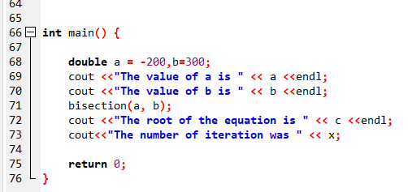
Code--

Slide 9
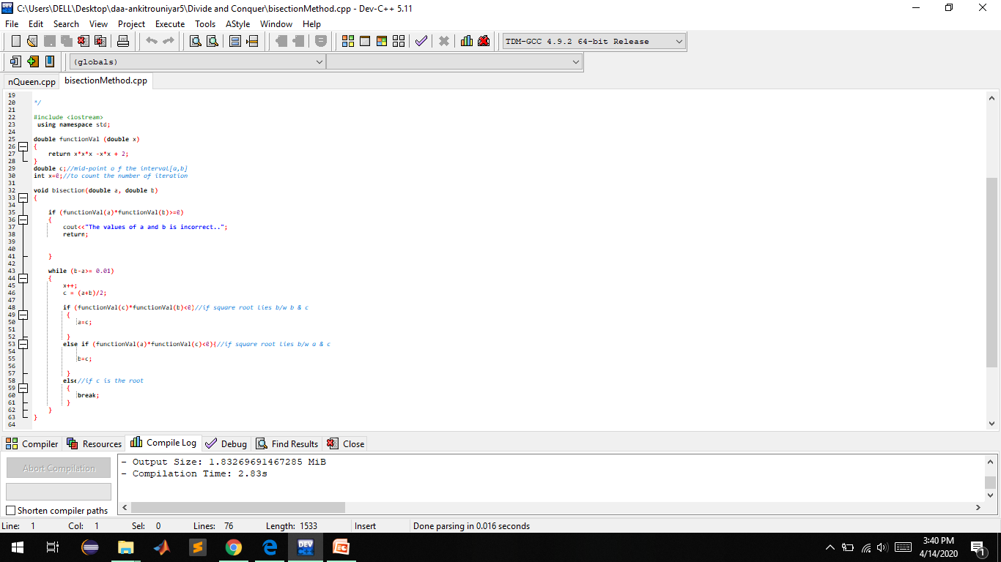

Slide 10
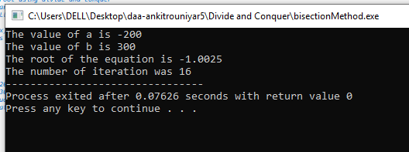
Output;

